Slide 1

How to Use this Presentation:
Double-check each slide carefully to be sure that all points are applicable to your plans.
Copy and paste the slides into your open enrollment presentation.
To increase your enrollment rate, we recommend that you present these slides after you discuss your medical, vision and dental plans.
If a slide has a video on it, simply click the video to open it in your browser.

Slide 2

Flexible Spending Account

Slide 3

What is an FSA?

Slide 4
Flexible Spending Account
An FSA is a spending account for health expenses. The account is tax-advantaged, meaning you can save up to 40% on thousands of everyday expenses. You decide how much money you want to set aside at the beginning of the year and that money is yours to use starting day one.

Slide 5

Flexible Spending Account
How much you can contribute:
$3,400
  This is the maximum set by the IRS. Please check with your Human Resources department for verification of your employer’s maximum contribution amount.
  Since it does not coordinate with insurance coverage, you do not have to participate in your employer’s medical plan to be eligible
  Any legal dependent can use your FSA funds, regardless of their insurance coverage status

Slide 6
Flexible Spending Account
Disclaimer: If you or your spouse currently contributes to a health savings account (HSA), you should check with your HR representative before enrolling in the FSA.

Slide 7
Eligible Expenses

Slide 8


Deductibles . Copays . Prescriptions

Slide 9

Teeth Cleaning

Slide 10

LASIK . Glasses . Contact Lenses

Slide 11
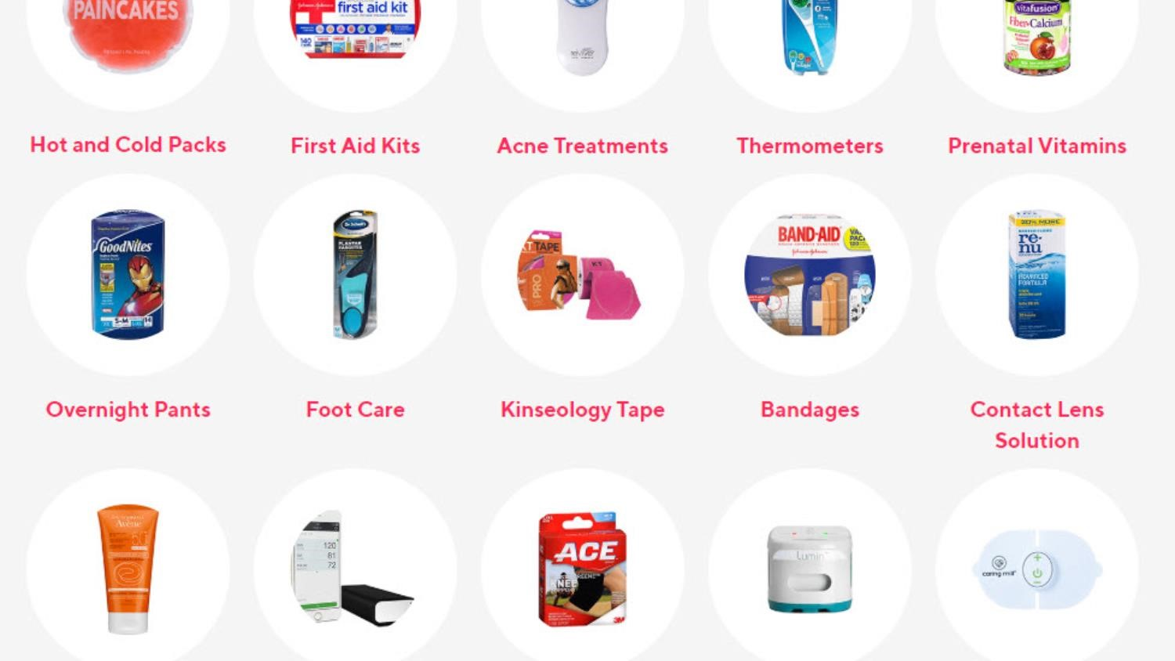
Over-the-Counter Medications. Menstrual Care products . And much more
Notes:
To review a few list of eligible expenses, log in to MyAmeriflex, visit the “Resources” tab, and select the Eligibility List from the Quick Navigation menu. https://myameriflex.com/resources/eligibility-list/
To shop FSA-eligible items at Care Covered, a sister company of Ameriflex, visit https://www.carecovered.com/.

Slide 12

Flexible Spending Account
Use It or Lose It
Because of the special tax treatment applied to FSAs, the IRS has rules in place governing the use of FSA funds. One rule states that any unused FSA funds remaining in your account at the end of the eligible claims period must be forfeited and will not roll over to the next plan year. This is sometimes referred to as the “Use it or Lose it” rule.

Slide 13
Flexible Spending Account
Use It or Lose It (Continued)
To avoid forfeiting any unused at the end of your plan year, please keep in mind:
Eligible FSA claims must be incurred within the eligible claims period that is specified in your employer’s plan. (Check with your HR department for more information about plan year dates.)
To be reimbursed for an eligible expense, the date of the service rendered or the date on which an expense was incurred must fall within the eligible claims period. Billing dates or statement dates are irrelevant.
Plan ahead! Planning ahead will help you come up with a reasonable estimate of what your expenses might be and help avoid losing any unused funds.

Slide 14

Flexible Spending Account
$680 Roll-Over Provision
For those employer groups that elect the roll-over option, participants in the FSA will be allowed to roll over up to $680 in unused FSA funds, for use in the following plan year. Check with your HR department to see if you qualify.
Applies only to unused FSA funds
An employer can select the roll-over option, however they are not allowed to also offer the 2.5 month extension
Employers do not have to adopt this rule, so please check with your HR department for verification

Slide 15
Flexible Spending Account
$680 Roll-Over Provision (Continued)
For those employer groups that elect the roll-over option:
This provision does not affect the ability to elect the maximum amount the following year. Even if funds are rolled over from a previous plan year, a participant can still elect up to the maximum FSA contribution amount allowed under their plan. For instance, if a participant rolls over $680 from the 2025 plan year, and his/her employer allows them to make a $3,400 FSA contribution for the 2026 plan year, the participant can still elect the full $3,400 and roll over $680 from the prior year.

Slide 16

Support
Download the Mobile App
Call us at: 888.868.3539
Visit us at: www.myameriflex.com

Slide 17

Questions?

