Slide 1



ICHRA Refresher and
Telescope Health
for Brokers & Employers
Notes:
Introduction- Jeff

Slide 2



Kameron Burgess
Regional Sales Manager, Ameriflex
Paul Sapia
Chief Population Health Officer, Telescope Health
Notes:
Jeff speaks

Slide 3

What We’ll Cover
What an ICHRA really is (beyond the textbook)
How it works for employers and employees in practice
How Telescope Health fits in
Notes:
Jeff

Slide 4
What is an ICHRA, really?
An Individual Coverage HRA that lets employers reimburse employees tax-free for individual health insurance premiums and medical expenses.
Beyond the Definition
Flexible by employee class
No minimum or maximum contribution limits
Works alongside, not instead of , good benefits strategy
Notes:
Jeff

Slide 5
How It Works in Practice
For Employers
Set reimbursement amounts → define eligibility → stay compliant
For Employees
Choose their own plan → submit expenses → get reimbursed
The experience depends entirely on how it's designed and supported.
Notes:
Jeff

Slide 6
ICHRA Payments Solved
Ameriflex simplifies the payment experience by reconciling member-level data before funds are sent, helping carriers receive cleaner, more actionable payment information.
The Result
Reduced administrative burden
Greater payment accuracy
Simplified carrier reconciliation
A more scalable ICHRA experience
Notes:
Jeff

Slide 7
Where Telescope Health Fits In
Virtual care that integrates directly into your ICHRA strategy.
Fills gaps in individual market plans
Improves day-to-day employee experience
Easy to access, easy to use
Notes:
Jeff

Slide 8

Telescope Slides
Notes:
Jeff

Slide 9


Slide 10


Slide 11
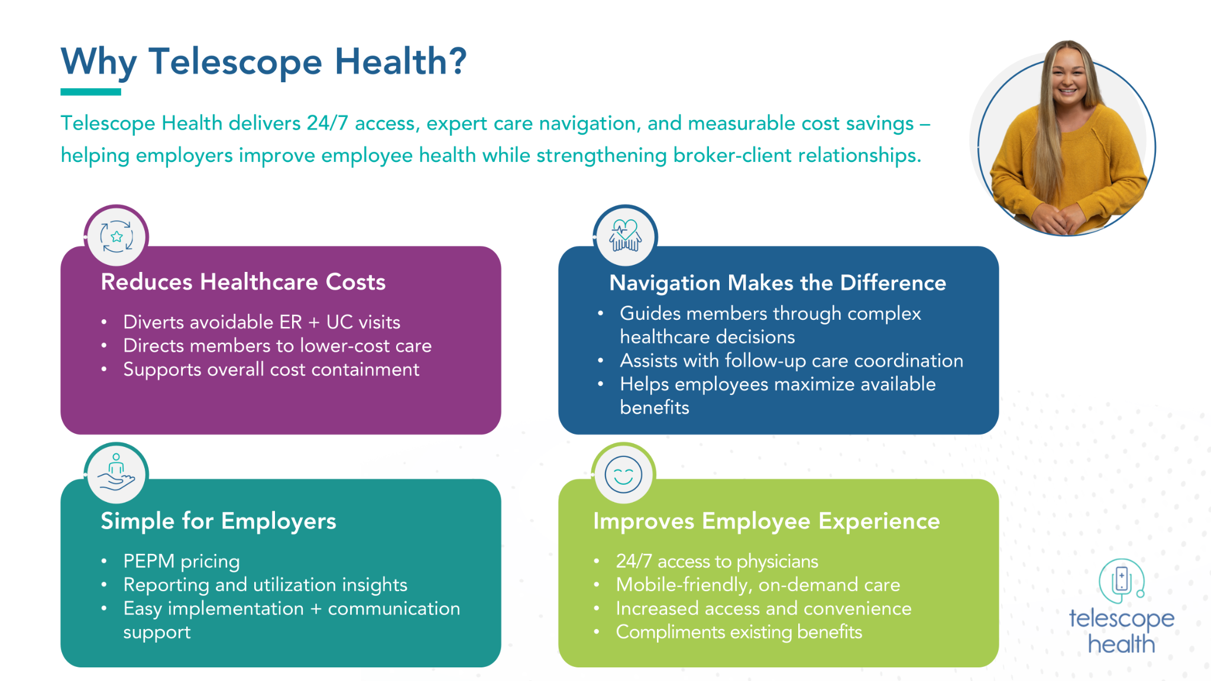

Slide 12


Slide 13


Slide 14
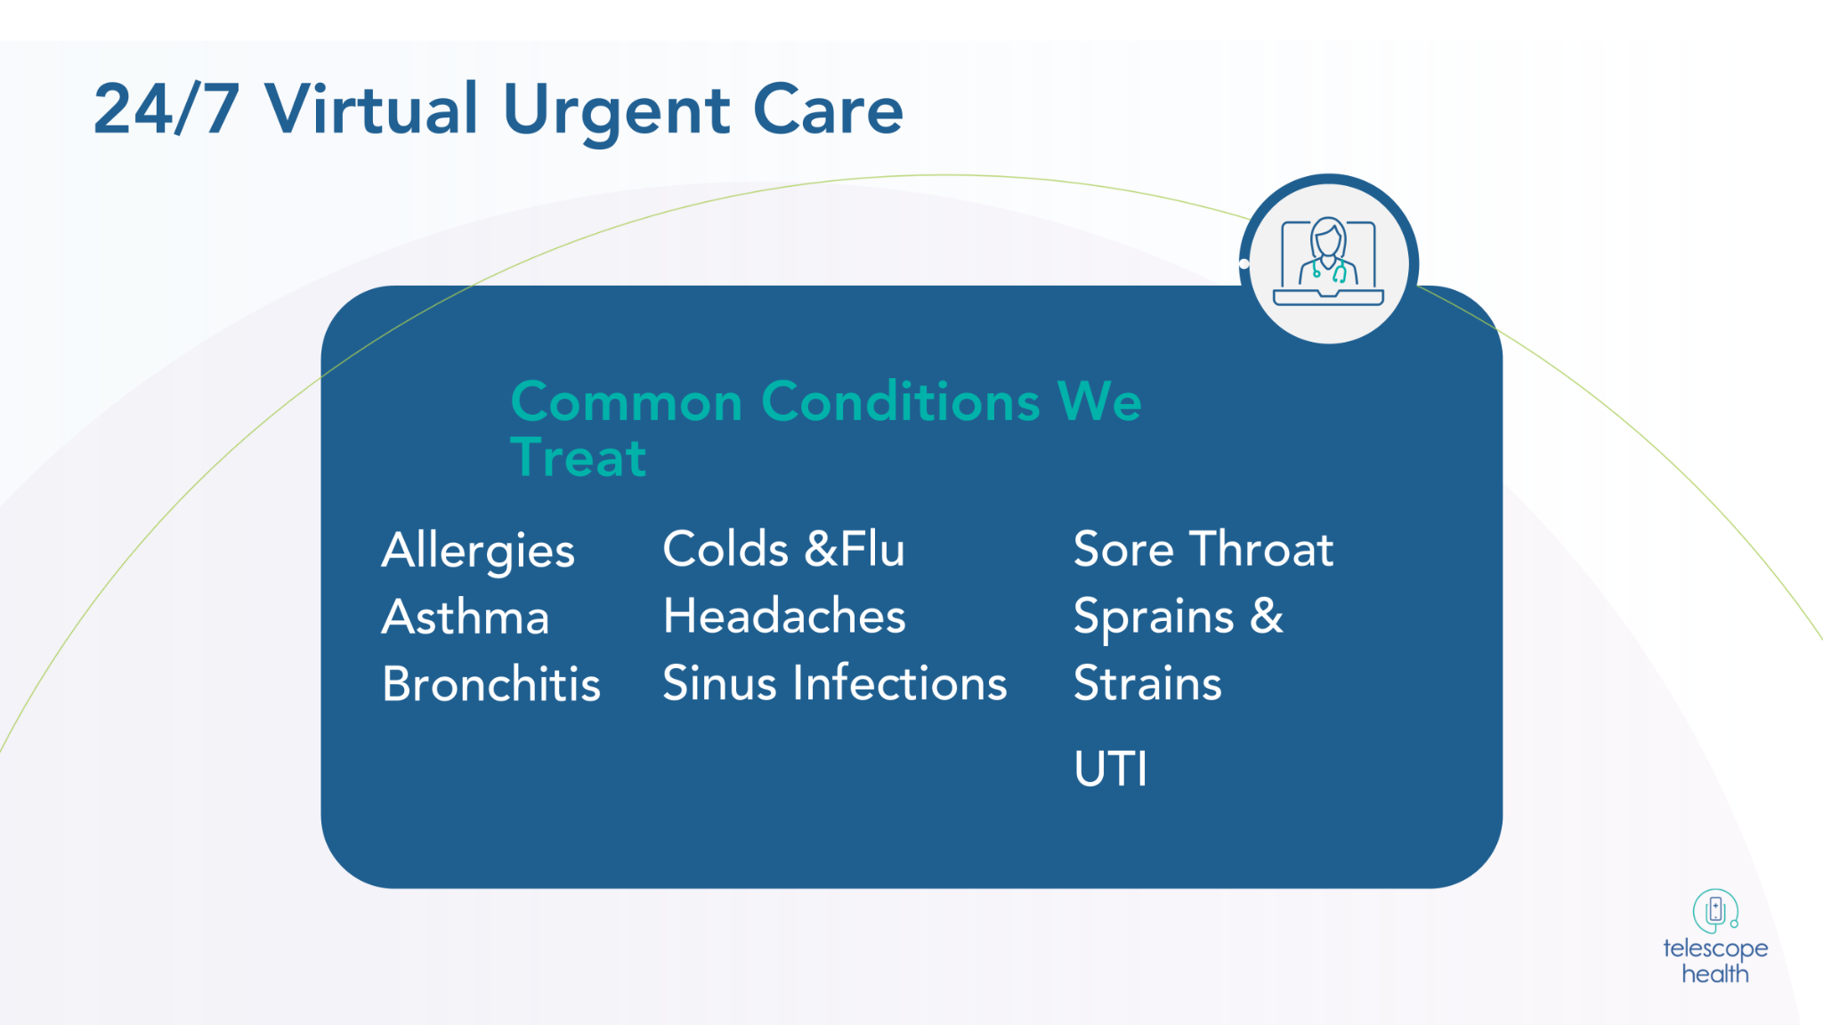

Slide 15


Slide 16
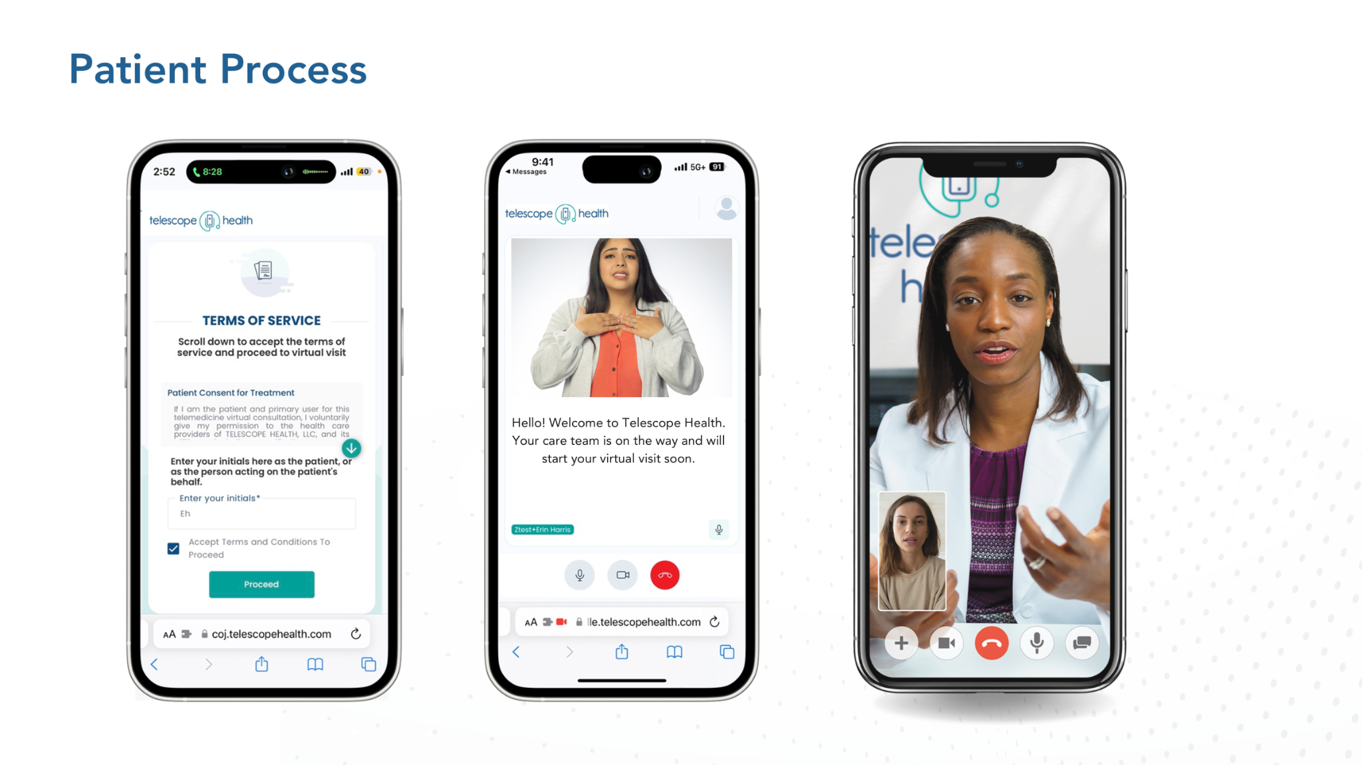

Slide 17


Slide 18
Q&A
Notes:
Jeff

Slide 19
Ready When You Are
For administrative questions: ameriflex@telescopehealth.com
For marketing or collateral needs: sreid@telescopehealth.com
Download Telescope Health Demo
Replay link will be emailed to you
Follow Us on LinkedIn: www.linkedin.com/company/ameriflex/
Go to myameriflex.com for our guides and webinars
Request a Proposal
Contact Ameriflex
Notes:
Jeff

